Slide 1

PREPARED BY TEAM A, BATCH 97.
LIBRARY MANAGEMENT SYSTEM

Slide 2



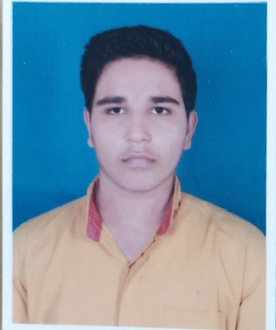


D R RIYAA
POOJASHREE SRINIVAS
NIKITA JAPADE
TANMAY UPADHYAY
RAVIKIRAN G R
SHUBHA VIJAYKUMAR

Slide 3


PROBLEM STATEMENT:
TO CREATE A LIBRARY MANAGEMENT SYSTEM THAT ALLOWS
1 USERS TO CREATE AN ACCOUNT TO BORROW & RETURN THE BOOKS.
2 ADMIN TO KEEP TRACK ISSUED AND RETURNED BOOKS.

Slide 4



DESCRIPTION:
A USER LOGS INTO THE WEBSITE USING THE CREDENTIALS WHICH IS VALIDATED BY THE SYSTEM AND CAN SEARCH FOR THE BOOK, BORROW A BOOK OR RETURN A BOOK.
IF THE CREDENTIALS PROVIDED BY THE USER IS WRONG THE SYSTEM ALERTS THE USER WITH AN ERROR MESSAGE.
IF THE USER HAS NOT CREATED AN ACCOUNT THEN THE USER CAN SIGN UP.

Slide 5
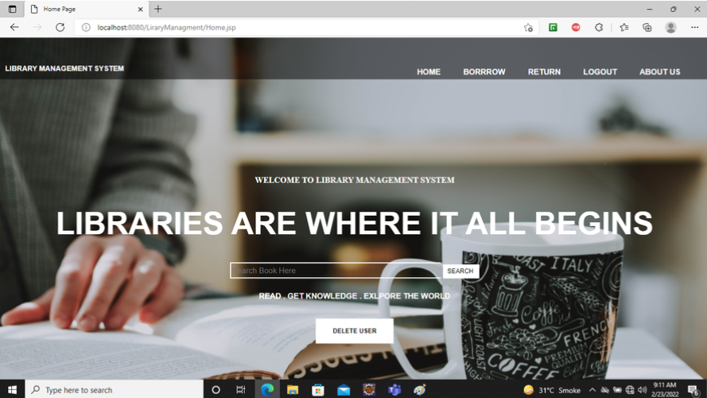
OUTPUT:

Slide 6

TECHNOLOGIES USED
FRONT END :
HTML, CSS, JAVA SCRIPT
BACK END :
SPRING, JAVA, MYSQL
TOOLS USED:
SPRING MVC
ECLIPSE
MYSQL WORKBENCH

Slide 7

EXECUTION OF THE PROGRAM:

